Slide 1
Introduction to
International Business Administration

Slide 2
Differences in Culture

Slide 3
Prof. Dr. Amit Shah
Notes:
This is a test

Slide 4
Differences in Culture
Societies differ along cultural dimensions
What is culture?
How/why do social structure, religion, language influence cultural differences?
What are differences between culture and values in the workplace (corporate culture)?
Culture changes over time. What are some reasons behind this?
Implications for business managers

Slide 5
What is Culture?
Culture: a society’s (group’s) system of shared, learned values and norms; these are the society’s (group’s) design for living
  Values: ideas about what a group believes to be good, right, and desirable
  Norms: the social rules that govern the actions of people toward one another
    Folkways: routine conventions of everyday life
      dress code; table manners; timeliness
    Mores: norms central to functioning of social life
      bring serious retribution: thievery, adultery, alcohol
Notes:
European cultures such as Germany, Netherlands, and the Scandinavian countries. Businesspeople are very conscious about scheduling their time and are quickly irritated when their time is wasted because a business associate is late for a meeting or if they are kept waiting.
Norms are social rules for acceptable behaviors between people
IST = Indian standard time → fashionably late
Time is flexible
Sharia → do’s/don’t of muslim law

Slide 6
National Culture
“Nation” is a useful:
  Definition of society
    similarity among people a cause -- and effect -- of national boundaries
  Way to bound and measure culture for conduct of business
    culture is a key characteristic of society
    can differ significantly across national borders
      also within national borders
Culture is both a cause and an effect of economic and political factors that vary across national borders

Slide 7
Determinants of Culture
  Values and norms of a culture evolve based on:
    Prevailing political and economic philosophies.
    Society’s social structure.
    Dominant religion, language, and education.
Notes:
Ultimately, a culture forms when people’s behaviors—as a result of these various influences—become ingrained in people’s daily activities, patterns, and ways of doing things.
The chain of causation runs both ways. While factors such as social structure and religion clearly influence the values and norms of a society, the values and norms of a society can influence social structure and religion.

Slide 8
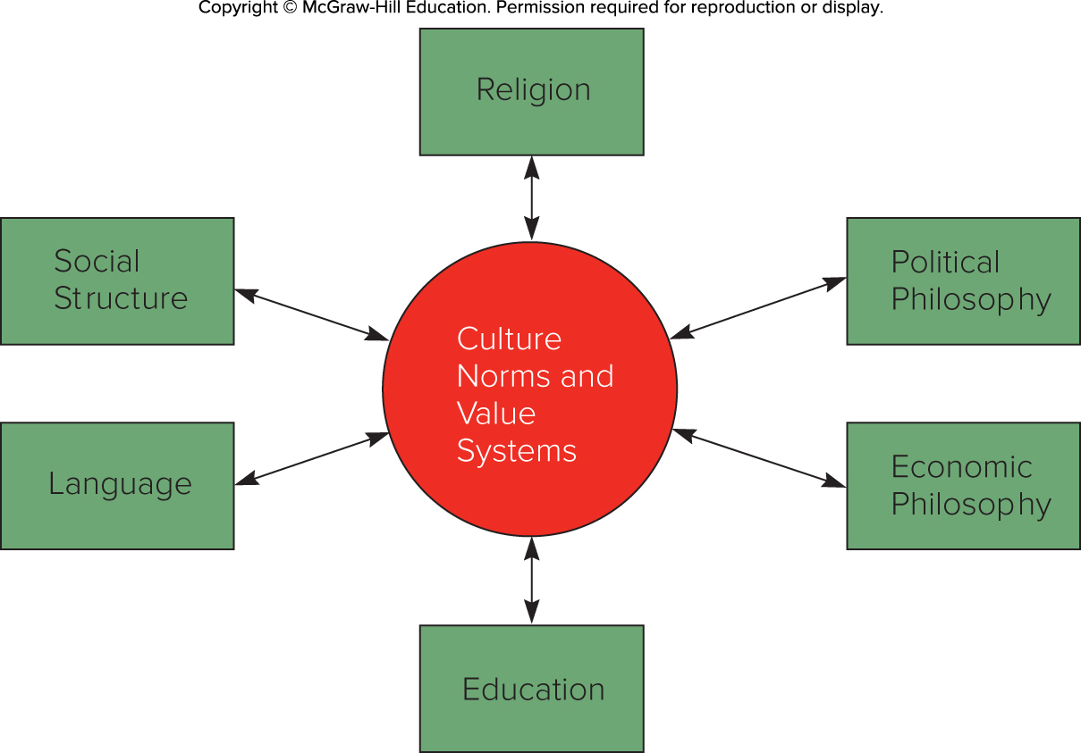
Determinants of Culture

Slide 9
Social Structure
Social Organization
  A society's social structure is its basic social organization.
  Two dimensions to consider:
    Degree to which the basic unit of social organization is the individual, as opposed to the group.
    Degree to which a society is stratified into classes or castes.
Notes:
Two dimensions are particularly important when explaining differences across social structures (although many dimensions exist beyond these two).
The first is the degree to which the basic unit of a social organization is the individual, as opposed to the group, or even company for which a person works. In general, Western societies tend to emphasize the importance of the individual, whereas groups tend to figure much larger in many non-Western societies.
The second dimension is the degree to which a society is stratified into classes or castes. Some societies are characterized by a relatively high degree of social stratification and relatively low mobility between strata (India). Other societies are characterized by a low degree of social stratification and higher mobility between strata (United States).

Slide 10
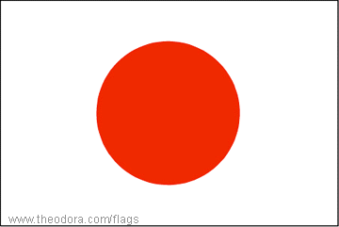

Individual vs. Group Societal Characteristics
Individual
  Managerial mobility between companies
  Economic dynamism, innovation
  Good general skills
  Teamwork difficult,
  non-collaborative
Exposure to different ways of doing business
  e.g., U.S. companies
Group
  Loyalty and commitment to company
  In-depth knowledge of company
  Specialist skills
  Easy to build teams, collaboration
  Emotional identification with group or company
  e.g., Japanese companies
Notes:
Individualistic: also australia

Slide 11
Social Structure
Social Stratification
All societies are stratified on a hierarchical basis into social categories, or social strata.
    Often defined by family background, occupation, and income.
Societies differ in terms of:
    Degree of mobility between social strata.
    Significance attached to social strata in a business context.
Notes:
Individuals are born into a particular stratum. They become a member of the social category to which their parents belong. Individuals born into a stratum toward the top of the social hierarchy tend to have better life chances than those born into a stratum toward the bottom of the hierarchy.

Slide 12
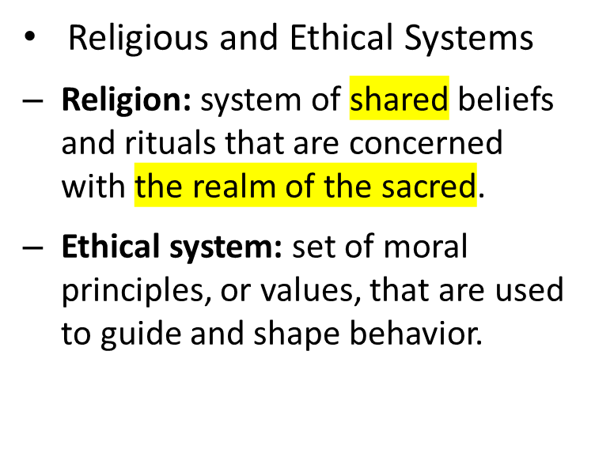
Religious and Ethical Systems
Religions with the greatest following are:
    Christianity (2.20 billion adherents).
    Islam (1.60 billion adherents).
    Hinduism (1.10 million adherents).
    Buddhism (535 million adherents).
    Confucianism, which shapes culture in many parts of Asia.

Slide 13
Religion, Ethics and Culture
Major religious groups and some economic implications:
  Christianity protestant work ethic
  Islam Islamic economic principles
  Hinduism anti-materialistic, socially stratified
  Buddhism anti-materialistic, social equality
  Confucianism hierarchy, loyalty, honesty
  Do not stereotype!!

Slide 14
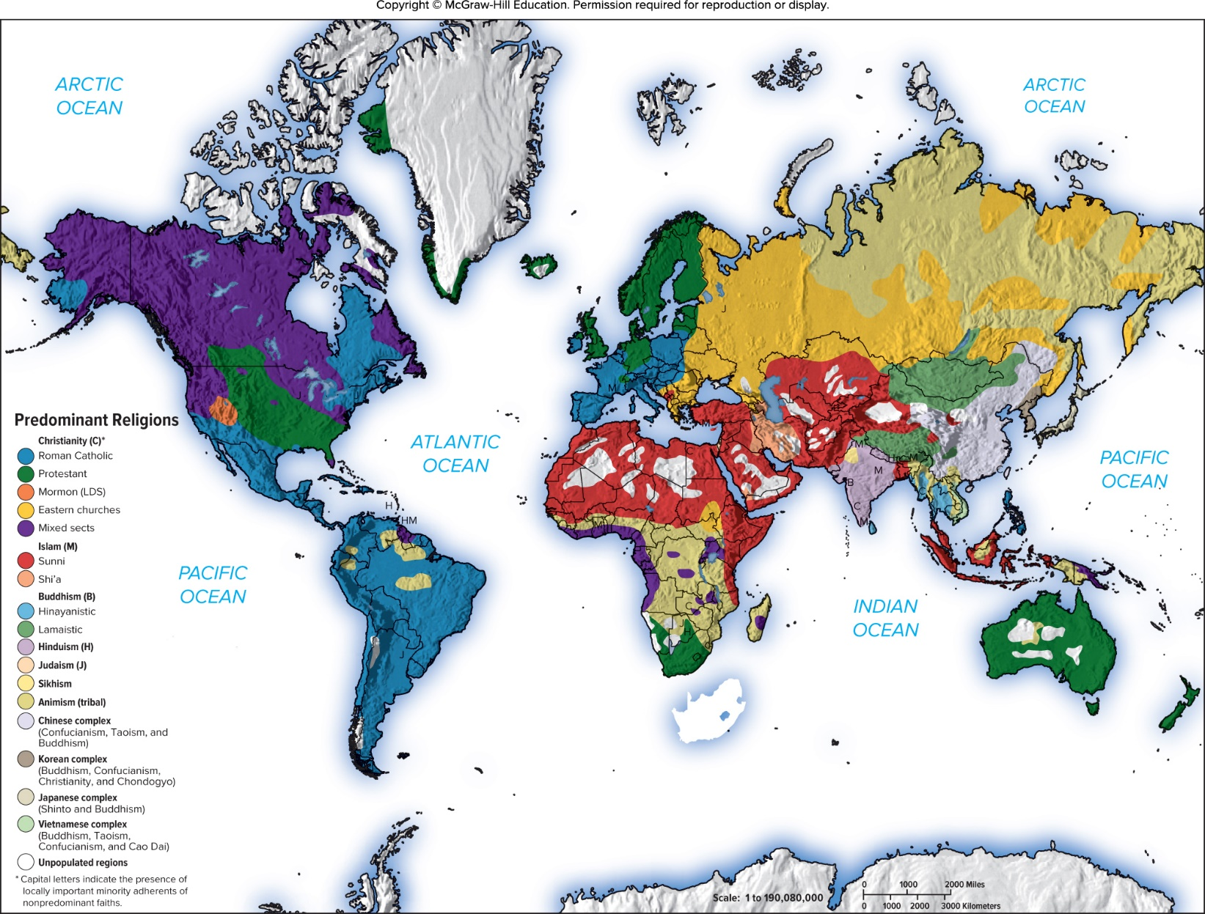
World Religions
Notes:
The relationship among religion, ethics, and society is subtle and complex. Of the thousands of religions in the world today, four dominate in terms of numbers of adherents: Christianity with roughly 2.20 billion adherents, Islam with around 1.60 billion adherents, Hinduism with 1.10 billion adherents (primarily in India), and Buddhism with about 535 million adherents.

Slide 15
Religious and Ethical Systems
Christianity
Most widely practiced religion.
In 19 04, Max Weber suggested that the Protestant work ethic was the driving force of capitalism.
    Focus on hard work, wealth creation, and frugality.
    Protestantism gave individuals more freedom to develop own relationship with God, which may have paved way to economic freedom.
Some scholars claim connection between Protestant-inspired individualism and entrepreneurial activity in a nation.
Notes:
Max Weber argued that Protestant ethics emphasizes the importance of hard work and wealth creation (for the glory of God) and frugality (abstinence from worldly pleasures). According to Weber, this kind of value system was needed to facilitate the development of capitalism. Protestants worked hard and systematically to accumulate wealth.

Slide 16
Religious and Ethical Systems
Islam
  Second largest of major world religions.
  Adherents of Islam are referred to as Muslims.
  One true omnipotent God, Allah.
  Those who forgo worldly ambitions to seek the favor of Allah may gain the greater treasure—entry into paradise.
Glow Images
Notes:
Major principles of Islam include (1) honoring and respecting parents, (2) respecting the rights of others, (3) being generous but not a squanderer, (4) avoiding killing except for justifiable causes, (5) not committing adultery, (6) dealing justly and equitably with others, (7) being of pure heart and mind, (8) safeguarding the possessions of orphans, and (9) being humble and unpretentious. Obvious parallels exist with many of the central principles of both Judaism and Christianity.

Slide 17
Religious and Ethical Systems
Islam (continued)
Economic Implications of Islam.
    Koran establishes explicit economic principles—many of which are pro-free enterprise.
    Under Islam, people do not own property but only act as trustees for God and thus must take care of what they are entrusted with.
    Stresses living up to contractual obligations, keeping one’s word, and abstaining from deception.
    Islamic banks have experimented with two different banking methods—the mudarabah and the murabaha.
Notes:
Given the Islamic proclivity to favor market-based systems, Muslim countries are likely to be receptive to international businesses as long as those businesses behave in a manner that is consistent with Islamic ethics, customs, and business practices. Businesses that are perceived as making an unjust profit through the exploitation of others, by deception, or by breaking contractual obligations are unlikely to be welcomed in an Islamic country. In Islamic countries where fundamentalism is on the rise, general hostility toward Western-owned businesses is likely to increase.
Under mudarabah, when an Islamic bank lends money to a business, rather than charging that business interest on the loan, it takes a share in the profits that are derived from the investment. Many believe that a mudarabah system is less efficient than a conventional Western banking system.
In a murabaha contract, when a firm wishes to purchase something using a loan—let’s say a piece of equipment that costs $1,000—the firm tells the bank after having negotiated the price with the equipment manufacturer. The bank then buys the equipment for $1,000, and the borrower buys it back from the bank at some later date for, say, $1,100, a price that includes a $100 markup for the bank.

Slide 18
Religious and Ethical Systems
Hinduism
  World’s oldest major religion.
  Moral force in society requires acceptance of certain responsibilities called dharma.
  Believe in reincarnation and karma.
  Individuals can eventually achieve nirvana by devoting their lives to spiritual (not material) quest.
Notes:
Hinduism has approximately 1.10 billion adherents, most of them on the Indian subcontinent. Hinduism began in the Indus Valley in India more than 4,000 years ago, making it the world’s oldest major religion. Unlike Christianity and Islam, its founding is not linked to a particular person.
Dharma → taking care of parents “what is a right thing to do”
Reincarnation → you will be born again; when you behave good you will be born as something better

Slide 19
Religious and Ethical Systems
Hinduism (continued)
Economic Implications of Hinduism.
    Max Weber: Hinduism does not foster entrepreneurism.
    Modern India is a dynamic entrepreneurial society.
    Mahatma Gandhi embodied Hindu asceticism.
    Historically, Hinduism also supported India’s caste system, which still influences Indian life.
Notes:
Given the emphasis on an ascetic lifestyle, Weber thought that devout Hindus would be less likely to engage in entrepreneurial activity than devout Protestants.
It has been argued that the values of Hindu asceticism and self-reliance that Gandhi advocated had a negative impact on the economic development of post-independence India.

Slide 20
Religious and Ethical Systems
Buddhism
Suffering originates in people’s desire for pleasure.
Stresses spiritual growth and afterlife, rather than achievement while in this world.
The Noble Eightfold Path.
Economic Implications of Buddhism.
    Does not support caste system.
    Recent trend of “Zen” orientation into Western businesses.
Notes:
Siddhartha offered the Noble Eightfold Path as a route for transformation. This emphasizes right seeing, thinking, speech, action, living, effort, mindfulness, and meditation. Unlike Hinduism, Buddhism does not support the caste system.
LO 4-3 Identify the business and economic implications of differences in culture.
Buddhism does not support the caste system, so individuals do have some mobility and can work with individuals from different classes.
“In business, ‘Zen’ is often a synonym for ordinary nothingness,” blogged Nancy Friedman, a corporate copywriter who consults with businesses on naming and branding. She said that “Zen can be combined with mail to describe ‘an incoming e-mail message with no message or attachments.’ Zen spin is a verb meaning ‘to tell a story without saying anything at all.’ And to zen a computing problem means to figure it out in an intuitive flash—perhaps while you’re plugged into the earphones of your ZEN MP3 player, available from Creative.”

Slide 21
Religious and Ethical Systems
Confucianism
Until 19 49, official ethical system of China.
Not a religion, but a guiding ideology.
    High moral and ethical conduct and loyalty to others.
    Attain personal salvation through right action.
Economic Implications of Confucianism.
    Three key teachings of Confucianism: loyalty, reciprocal obligations, and honesty.
    May lead to a lowering of the cost of doing business in Confucian societies.
Notes:
In Confucian thought, loyalty to one’s superiors is regarded as a sacred duty—an absolute obligation. However, in a Confucian culture, loyalty to one’s superiors, such as a worker’s loyalty to management, is not blind loyalty. The concept of reciprocal obligations is important.
LO 4-3 Identify the business and economic implications of differences in culture.
Confucian thinkers emphasize that although dishonest behavior may yield short-term benefits for the transgressor, dishonesty does not pay in the long run. The importance attached to honesty has major economic implications.
When companies can trust each other not to break contractual obligations, the costs of doing business are lowered. Expensive lawyers are not needed to resolve contract disputes. In a Confucian society, people may be less hesitant to commit substantial resources to cooperative ventures than in a society where honesty is less pervasive. When companies adhere to Confucian ethics, they can trust each other not to violate the terms of cooperative agreements. Thus, the costs of achieving cooperation between companies may be lower in societies such as Japan relative to societies where trust is less pervasive.

Slide 22
Language: Culture Bound
Language, spoken
  Nature of a language structures how we perceive the world.
  Countries with more than one spoken language often have more than one culture.
  Chinese is the mother tongue of the largest number of people in the world.
  English is the most widely spoken language in the world and is becoming the language of international business.
  Learning local language is beneficial for business success.

Slide 23
Language: Culture Bound
Language, unspoken
  Nonverbal cues are important communication source.
  Examples include facial expressions and hand gestures.
  Personal space is the customary distance between two people.
  Many nonverbal cues are culturally bound and may be interpreted differently, resulting in misunderstandings.

Slide 24
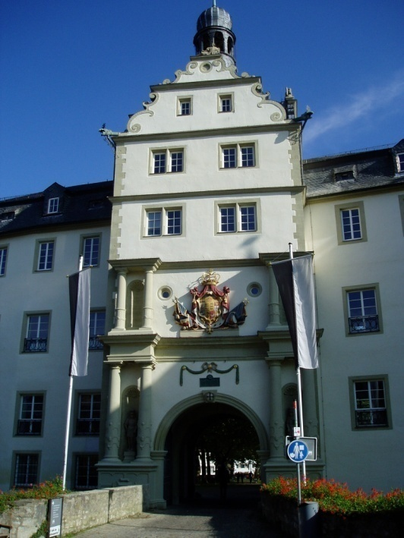
Education and Culture
Formal Education
Teaches the language, conceptual, and technical skills that are indispensable in modern society.
Educational opportunities can provide a competitive advantage and make a country more or less attractive for expanding businesses.
  Porter points to Japan’s excellent education system in explaining its postwar economic success.

Slide 25
Culture and Business
Importance of Culture
  Society’s culture affects values found in workplace.
  Geert Hofstede isolated five dimensions that summarized different cultures:
    Power distance.
    Individualism versus collectivism.
    Uncertainty avoidance.
    Masculinity versus femininity.
    Long-term versus short-term orientation.
Notes:
Hofstede’s power distance dimension focused on how a society deals with the fact that people are unequal in physical and intellectual capabilities.
The individualism versus collectivism dimension focused on the relationship between the individual and his or her fellows.
Hofstede’s uncertainty avoidance dimension measured the extent to which different cultures socialized their members into accepting ambiguous situations and tolerating uncertainty.
Hofstede’s masculinity versus femininity dimension looked at the relationship between gender and work roles.
The long-term versus short-term orientation dimension refers to the extent to which a culture programs its citizens to accept delayed gratification of their material, social, and emotional needs.
Indulgence refers to a society that allows relatively free gratification of basic and natural human drives related to enjoying life and having fun. Restraint refers to a society that suppresses gratification of needs and regulates it by means of strict social norms.

Slide 26
Work-Related Values for 15 Selected Countries
Country | Power Distance | Uncertainty Avoidance | Individualism | Masculinity | Long-Term Orientation
Australia | 36 | 51 | 90 | 61 | 31
Brazil | 69 | 76 | 38 | 49 | 65
Canada | 39 | 48 | 80 | 52 | 23
Germany (F.R.) | 35 | 65 | 67 | 66 | 31
United Kingdom | 35 | 35 | 89 | 66 | 25
India | 77 | 40 | 48 | 56 | 61
Japan | 54 | 92 | 46 | 95 | 80
Netherlands | 38 | 53 | 80 | 14 | 44
New Zealand | 22 | 49 | 79 | 58 | 30
Notes:
Table summarizes data for 15 selected countries for the five established dimensions of individualism versus collectivism, power distance, uncertainty avoidance, masculinity versus femininity, and long-term versus short-term orientation (the Hofstede data were collected for 50 countries).
Western nations such as the United States, Canada, and United Kingdom score high on the individualism scale and low on the power distance scale. Latin American and Asian countries emphasize collectivism over individualism and score high on the power distance scale.
Japan’s culture has strong uncertainty avoidance and high masculinity. This characterization fits the standard stereotype of Japan as a country that is male dominant and where uncertainty avoidance exhibits itself in the institution of lifetime employment. Sweden and Denmark stand out as countries that have both low uncertainty avoidance and low masculinity (high emphasis on “feminine” values).

Slide 27
Work-Related Values for 15 Selected Countries
Country | Power Distance | Uncertainty Avoidance | Individualism | Masculinity | Long-Term Orientation
Pakistan | 55 | 70 | 14 | 50 | 00
Philippines | 94 | 44 | 32 | 64 | 19
Singapore | 74 | 8 | 20 | 48 | 48
Sweden | 31 | 29 | 71 | 5 | 33
Thailand | 64 | 64 | 20 | 34 | 56
United States | 40 | 46 | 91 | 62 | 29

Slide 28
Culture and Business
Two Other Cultural Frameworks
Global Leadership and Organizational Behavior Effectiveness (GLOBE) identifies nine cultural dimensions.
Power distance, uncertainty avoidance, humane orientation, institutional collectivism, in-group collectivism, assertiveness, gender egalitarianism, future orientation, and performance orientation.
World Values Survey (W V S) explores values and norms, how they change, and their impact on society and business.
Notes:
The Global Leadership and Organizational Behavior Effectiveness (GLOBE) instrument is designed to address the notion that a leader’s effectiveness is contextual.
The World Values Survey (WVS) is a research project spanning more than 100 countries that explores people’s values and norms, how they change over time, and what impact they have in society and business.
The WVS includes dimensions for support for democracy; tolerance of foreigners and ethnic minorities; support for gender equality; the role of religion and changing levels of religiosity; the impact of globalization; attitudes toward the environment, work, family, politics, national identity, culture, diversity, and insecurity; and subjective well-being.

Slide 29
Cultural Change
Culture evolves over time, although changes in value systems can be slow and painful.
    Social turmoil is an inevitable outcome of cultural change.
    Cultural change is particularly common as countries become economically stronger.
    As countries get richer, there is a shift from “traditional values” to “secular rational.”
  Globalization creating a convergence of cultures: the convergence hypothesis.
  Countertrend of some cultures: reemphasizing uniqueness.
Notes:
For another illustration of cultural change, consider Japan. Some academics argue that a major cultural shift has been occurring in Japan, with a move toward greater individualism. The model Japanese office worker, or “salaryman,” is characterized as being loyal to his boss and the organization to the point of giving up evenings, weekends, and vacations to serve the organization, which is the collective the employee is a member of. However, a new generation of office workers may not fit this model.
At the same time, we should not ignore important countertrends, such as the shift toward Islamic fundamentalism in several countries; the continual separatist movement in Quebec, Canada; ethnic strains and separatist movements in Russia; nationalist movements in the United Kingdom (Brexit); and the election of a populist, nationally oriented Donald Trump as the 45th president of the United States. Such countertrends are a reaction to the pressures for cultural convergence.

Slide 30
Small Cultural Differences in Europe vs. U.S. that could cause Problems
Sunday is the last day of the week in Europe, not the first.
Time is on a 24 basis, vs. 12 with AM,PM (although all clocks are 12 hour).
Dates are abbreviated dd/mm/yyyy, vs. mm/dd/yyyy in the U.S. Thus, 9/11 is 9 Nov. in Europe; 11 Sept in U.S.
Numbers are written: €12.013,45 vs. $12,013.45 (Excel)
Europeans write out their dates as: 9 November 2001. In the U.S, it would be November 9, 2001.
If today is Thursday, „next weekend“ starts a week from tomorrow in Europe, not one day from now as in U.S.
A4 paper is narrower and longer than letter size.
Germans use Mrs. (Frau), In U.S., use Ms. (Mizz), not Miss or Mrs.

Slide 31
End of Culture Lecture

